Slide 1
Coffee Quality
Manikandan Ayyasamy
DA/DS – November 2024
Python Reinforcement - 18/04/2025

Slide 2
OBJECTIVE
To clean and preprocess the data by handling missing values and outliers
To Standardize and transform the dataset for consistency across variables
Perform exploratory data analysis (EDA) to identify patterns and relationships
Derive actionable insights through visualizations and statistical analysis.

Slide 3
Contents
Species
Owner
Country of Origin
Altitude
Number of Bags
Grading Date
Variety
Processing Method
Aroma
Flavour
Acidity
Aftertaste
Body
Balance
Uniformity
Sweetness
Moisture
Quakers
Colour
Expiration

Slide 4
Data Cleansing and Preprocessing
01
02
03
Null Values
Missing values
Average Imputation
04
05
Outliers
Datatype Management
Identifying null values
Filling up the Null values
Filling values with Mean
Identifying Outliers from the data
Managing Data types for numerical values

Slide 5
Handling Missing Values
Fill
Mean
Used for Categorical data such as Farm, Region, Country.
Used for numerical data such as Altitude, Number of Bags, Bag Weight, Quakers, Category.
df_coffee['Country.of.Origin'] = df_coffee['Country.of.Origin'].fillna(method = 'ffill')
mean_altitude_mean = df_coffee['altitude_mean_meters'].mean()df_coffee['altitude_mean_meters'].fillna(mean_altitude_mean, inplace = True)

Slide 6
Handling Outliers
Negative Values
Incorrect Suffix
Incorrect Values
Negative values were replaced with mode – the most repeated value.
Example – Altitude.
Incorrect and uncommon suffix for columns with units.
Example – Bag Weight.
Incorrect outlier values out of the specific range of the provided parameter.
Example – Aroma.

Slide 7
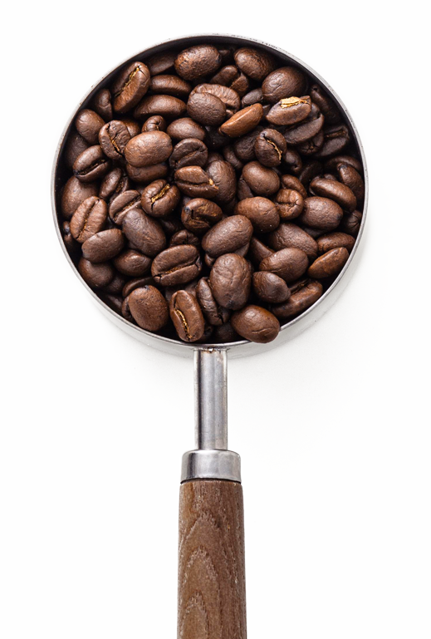
Statistical Analysis
T-Test for Flavor, Aftertaste, Aroma and Altitude
To determine if there is a significant difference in the scores between Arabica and Robusta coffee beans.
Based on the t-test, the mean flavor scores of Arabica and Robusta coffee beans are not significantly different in this dataset
The t-test revealed a statistically significant difference in the aftertaste scores between Arabica and Robusta coffee beans. This indicates that the aftertaste perception of these two coffee types is distinctly different.
Z-Test for Aroma and Altitude
Based on the z-test there is no significant difference from the population mean, indicating consistency in Aroma across coffee samples.
For Altitude there is a Significant difference observed in mean altitude, suggesting diverse cultivation environments.

Slide 8
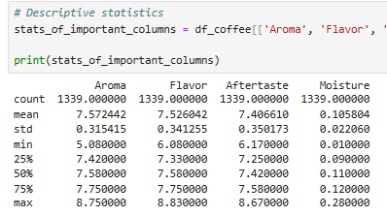
Descriptive Analysis
The mean scores for Aroma (7.57), Flavor (7.52), and Aftertaste (7.40) are relatively close, indicating overall consistent quality across coffee samples. Standard deviations (0.38, 0.34, 0.35) suggest variability but not extreme differences.
The mean moisture level is 0.10, indicating most samples have consistent moisture. This suggests that most coffee beans are properly stored, but a few may have issues with moisture control.
With average scores above 7 for Aroma (7.57), Flavor (7.52), and Aftertaste (7.40), the coffee beans show overall good quality. The mean values suggest good qualities across most samples.
Aroma is the only quality with the minimum value in the range of 5 whereas all the other qualities are higher than Aroma.

Slide 9
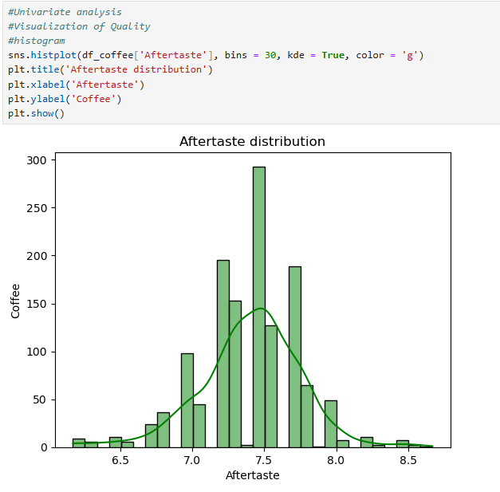
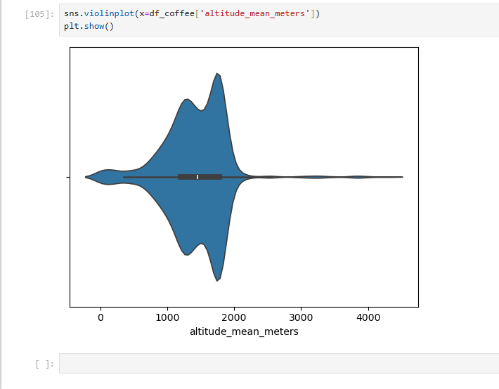
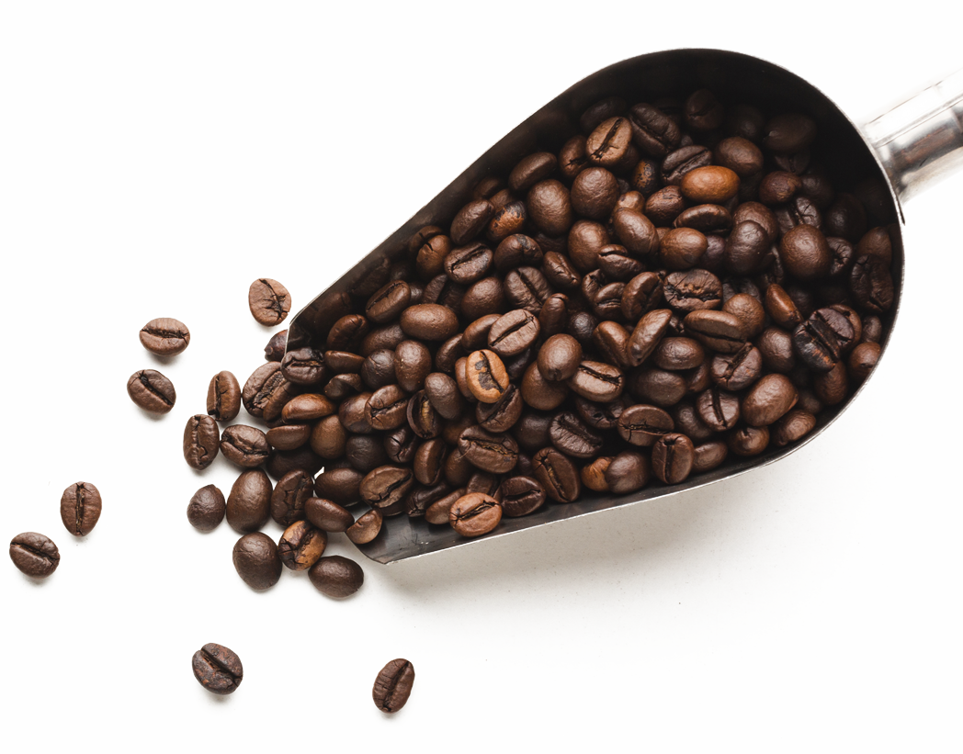
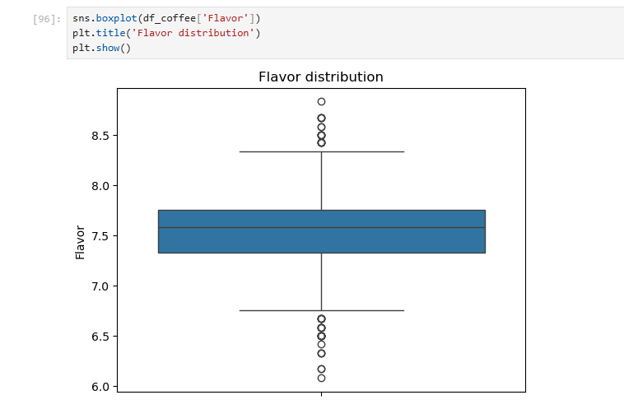
Univariate Analysis
Aftertaste of majority of the species comes between the 7 and 8, because of which the distribution is widely spread around the same region and not before or after that.
Flavor Distribution – the mean of flavor is 7.5 and the outliers identified using box plot are either above average or below average.
Most coffee is grown between 1000–1500 meters, with a strong concentration in this range. There are some extreme values above 4000 meters, showing the presence of rare high-altitude data points.

Slide 10
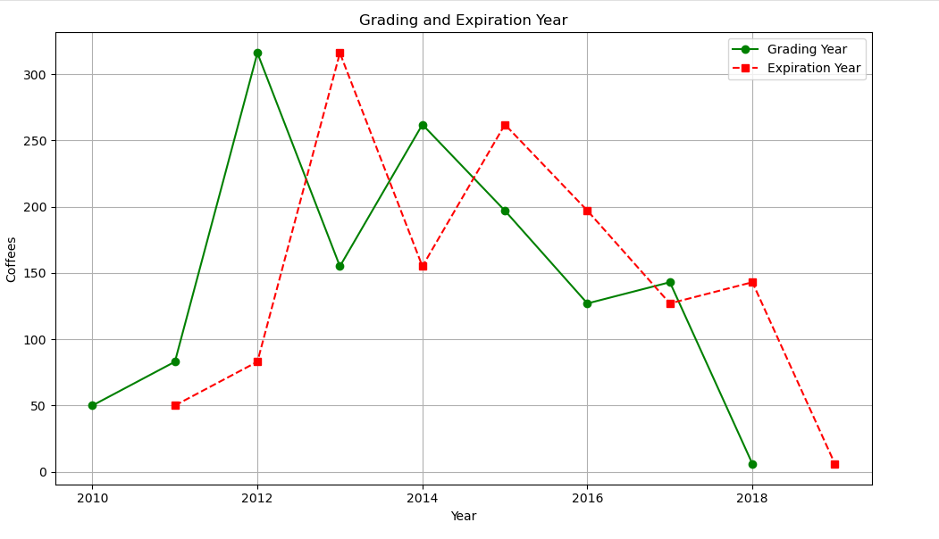
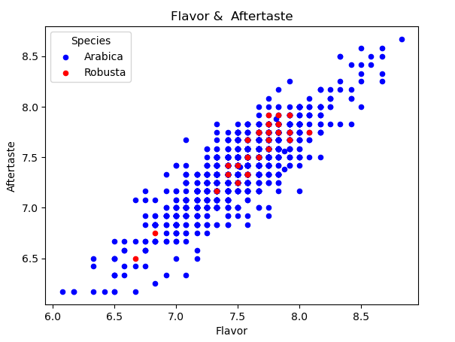
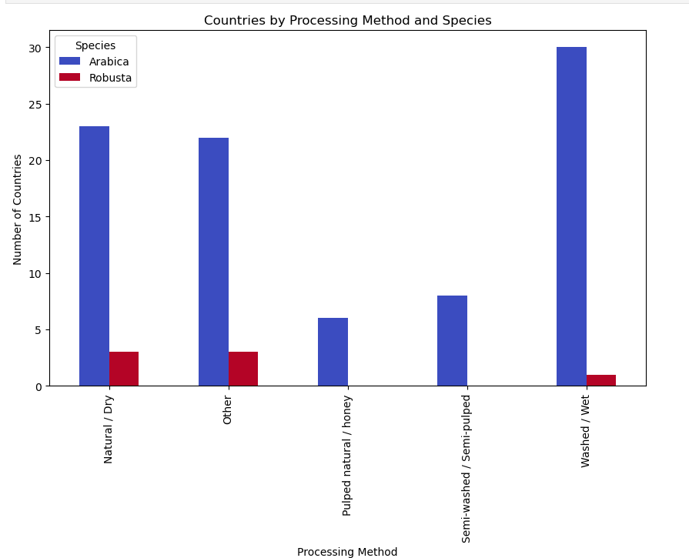
Bivariate Analysis
Flavor and Aftertaste
Preparation Method

Slide 11
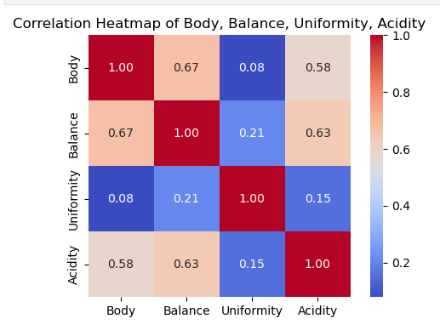
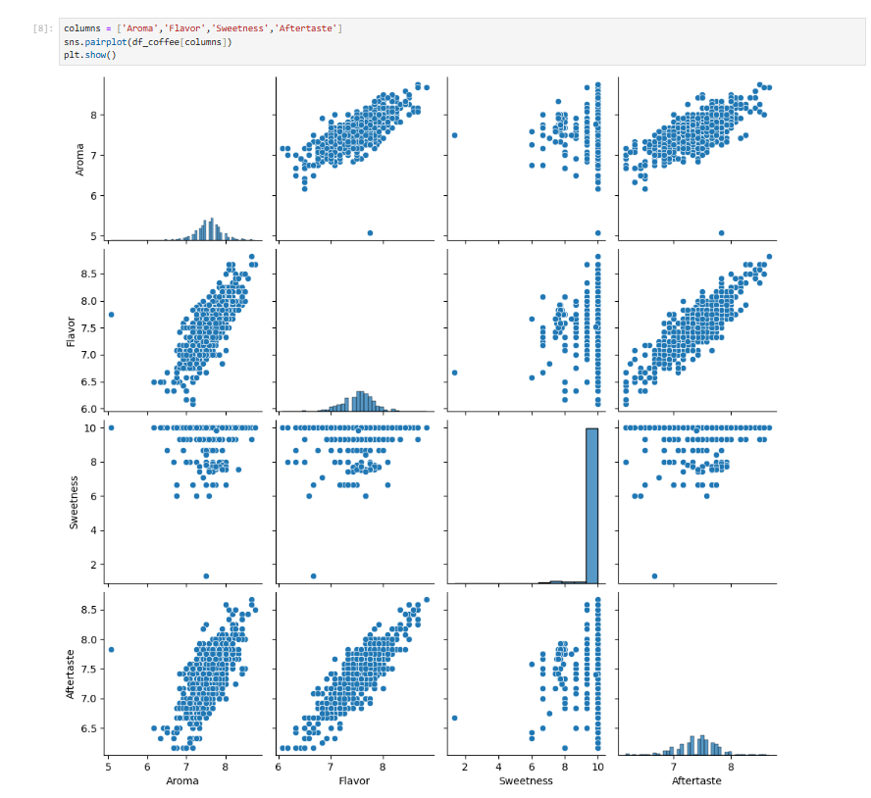
Multivariate Analysis
The scatter plots between Aroma vs. Flavor, Aroma vs. Aftertaste, and Flavor vs. Aftertaste show a clear linear relationship.
This suggests that coffees with higher aroma scores tend to also have higher flavor and aftertaste scores.
Coffees with a richer body usually have better balance. Enhancing body may improve overall harmony in flavor.
Uniformity has weak links to other traits because of which it doesn’t strongly relate to body, balance, or acidity. This suggests it's more about consistency than flavor.
A brighter acidity often leads to better body and balance. It's an important factor in quality coffee.

Slide 12
Important Insights
Aftertaste
Arabica and Robusta beans show a significant difference in aftertaste based on the t-test.
Quality
Aroma, Flavor, and Aftertaste all average above 7, indicating good and consistent coffee quality.
Outlier
Extreme values in flavor and aroma may signal inconsistencies in processing or storage.
Acidity
Unlike other traits, acidity shows greater spread, indicating it's a key factor in flavor diversity.

Slide 13
Recommendations
Aftertaste Enhancement
Altitude Maintainance
Aroma Relativity
Since it's a differentiator between bean types, improving aftertaste could boost perceived quality.
Focus sourcing efforts around 1000–1500 meters, the optimal growing zone for most samples.
Maintain high aroma scores as they strongly influence both flavor and aftertaste ratings.

Slide 14
—Someone Famous
Thank you!
Coffee is a kind of Magic you can drink.

